Slide 1
Concepts and Frameworks for approaching Urban Sustainability and Planning
Module 1 Urban Sustainability and Smart Cities
Dr. Asad Mohammed, Director of blueSpace

Slide 2
Sustainable development is the kind of development that meets the needs of the present without compromising the ability of future generations to meet their own needs.
Our Common Future, Brundtland Commission 1987

Slide 3
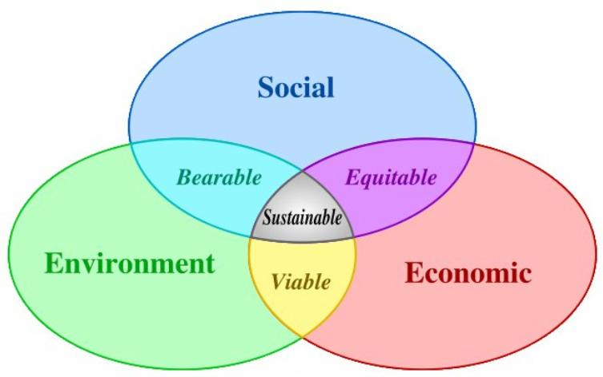
http://sustainabilityadvantage.com/wp-content/uploads/2010/07/Blog-07-20-10-Slide-3.jpg

Slide 4
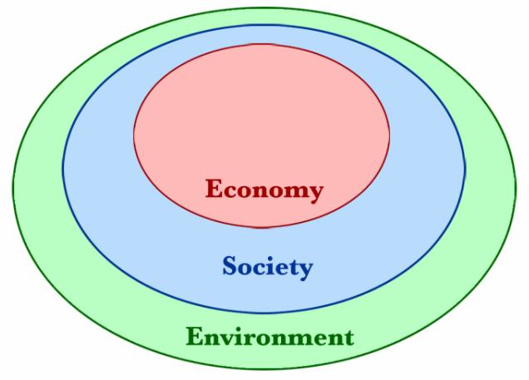
sustainability-circles2 copy

Slide 5
The core concept behind sustainable development has been the limitations in the carrying capacity of spaceship earth.

Slide 6
Domesday Book 1086
Thomas Malthus 1790s
Limits to Growth 1972

Slide 7
Ratios of population to Land
Limitations on the resources to support the population
Technology has improved the productivity of land

Slide 8
Unequal distribution and access to resources
Sustainable consumption

Slide 9
More than 50 % of World’s population Urbanised
“No sustainable Development
without sustainable Cities”
- CAP 2006

Slide 10
80% of Population of Latin America and the Caribbean Urbanised
-UNHabitat 2012
60-70% of Caribbean Population Urbanised
Low Density
Sprawled
Primate cities
Settlement classification problems

Slide 11
High levels of poverty
Predominance of the informal sector
Frequency of natural disasters
Forefront of climate change impacts
Digital Divide

Slide 12
Socio-spatial concentration of exclusion
High per unit costs of developing and maintaining infrastructure
Low tax recovery on urban services
High energy utilisation per activity

Slide 13
Sustainable cities
Socially sustainable cities
Inclusive cities
Livable cities
Compact Cities
Smart cities

Slide 14
Adaptation to climate change impacts
Mitigate against climate change

Slide 15
“The nature and form of the urban environment is a critical determinant of the sustainability of our society as it is responsible directly for a large proportion of consumed energy, and influences indirectly the patterns and modes of energy consumed in everyday activities.”(Rickwood, 2008)

Slide 16
Energy Consumption Percentages in Selected Cities
Source: UN-Habitat (2008)

Slide 17
Energy Subsidies in Trinidad and Tobago

Slide 18
Over five per cent of total Government expenditure is the subsidy on fuel.
The fuel subsidy on gasoline for 2013 was over $4 billion.
The current price of gasoline at the pump in the United States is approximately TT$ 5.30 per litre compared to our current price of $2.70 per litre for super unleaded
Consequence is that there is little incentive to reduce care use, car pool and people are not sensitive to the real economic cost of gasoline.
Hence Trinidad has too many cars on the road

Slide 19
Transportation, land use and the environment
The spatial location of activities like residence, work, shopping, production and consumption give some indications on the required travel demand and average distances between activities
It is over the matter of density that the relationships between transportation, land use and the environment can be the most succinctly expressed.
The higher the level of density the lower the level of energy consumption per capita and the relative environmental impacts.

Slide 20
Transportation issues in developing Countries
In developing cities where local technical capacity is weak, planning instruments are rudimentary and responsibilities, fragmented.
The development has been largely unplanned, and the provision of urban services has lagged due to limited budgets and inadequate technical capability
The location or direction of urban development influences transport investment, particularly in roads.
The poor, who tend to live on the fringes of cities, are usually burdened with the highest transport costs

Slide 21
Planning solutions in developing Countries
Substitutions of technology and alternate energy for sustainable consumption and rethinking the physical growth strategies .

Slide 22
Critical Issues in sustainable cities in the Caribbean
Brown vs the Green Agenda
Social and economic sustainability
Liveability more tangible than sustainability
Sustainable consumption important
Mitigation important for economic sustainability
Realistic urban planning an management
Smart Growth vs Smart cities

